Slide 1


Strategies to Progress
Mathew Wellons

Slide 2
Attaining $30 Million profit in 2019 is a jump, lets take it together!
Providing us with what we need to expand lariat to new heights

Slide 3
Where We Are…
We start this journey with our baseline data from 2018.

Slide 4
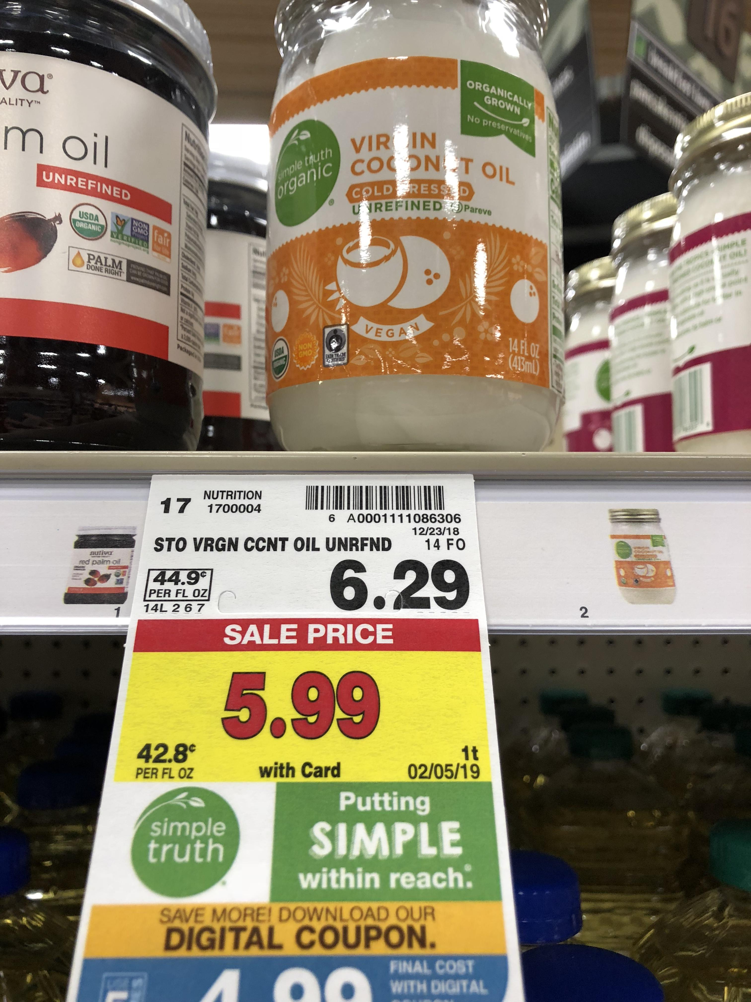
Pricing
Lariat is the only rental car company utilizing an old pricing scale. Let’s change that!

Slide 5
Out with the old…
Current pricing
$ 148.00
$ 103.00
$ 198.00
$ 237.00
$ 97.00
$ 113.00
$ 181.00

Slide 6
Out with the old…
Current pricing
Proposed pricing
$ 148.00
$ 103.00
$ 198.00
$ 237.00
$ 97.00
$ 113.00
$ 181.00
$ 149.99
$ 109.99
$ 199.99
$ 239.99
$ 99.99
$ 119.99
$ 189.99

Slide 7
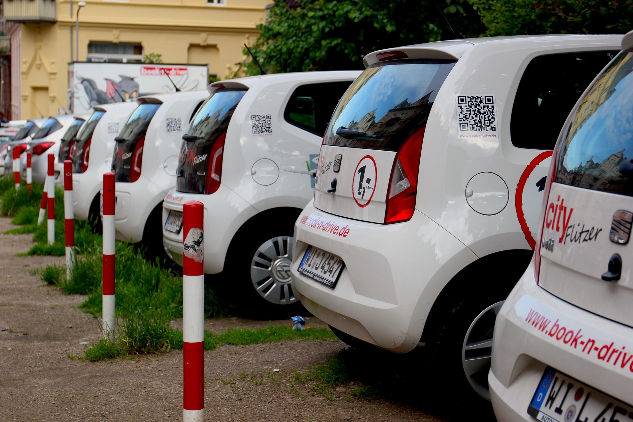
Locations
Network is everything! Our network could use some more… just more!

Slide 8
In with the new!
Top ten branches
Bottom ten branches

Slide 9
What’s the plan?
Baseline Data: Summary of 2018 Data

Slide 10
What’s the plan?
Strategy 1: Increase pricing by rounding up to nearest $9.99 and adding 10% to higher risk customers

Slide 11
What’s the plan?
Strategy 2: Increase number of locations, and as a result, vehicles and days rented

Slide 12
What’s the plan?
Strategy 3: Combine tactics from Strategies 1 and 2

Slide 13
Where We Are Going…
By simply applying strategy 3, the combined approach of increasing our pricing and location count, we project a profit of around $32.5 Million in 2019!

Slide 14
Let’s Do This Together
Recommended Strategy for 2019: Strategy 3, increasing locations and pricing

Slide 15
Any Questions?
Your leave behind material includes most documentation and data

Slide 16
We will make our goal!
A special thanks to: https://fictionalcompanies.fandom.com/wiki/Lariat_Rent-A-Car

